Slide 1

IOT BASED PARKING SLOT FINDER
“SMART-PARKO”
GUIDE:HAREESH KUMAR CH
TEAM:
T P M ABDULKAREEM
NAZNA AA
THAFSEERA K
SAFEENA C

Slide 2

INTERNET OF THINGS
IoT is a network of physical objects with embedded electronics that collect and share data
The Global Standards Initiative on Internet of Things (IoT-GSI) defined the IoT as "the infrastructure of the information society".
The IoT allows objects to be sensed or controlled remotely across existing network infrastructure, creating opportunities for more direct integration of the physical world into computer-based systems, and resulting in improved efficiency, accuracy and economic benefit in addition to reduced human intervention

Slide 3
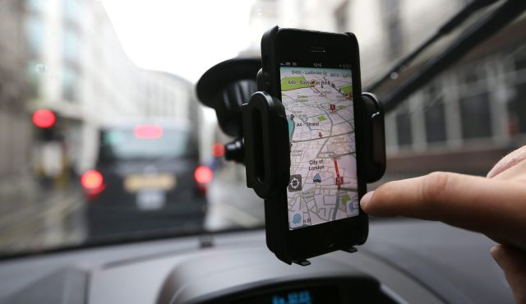
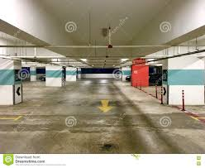
What is IOT based smart-parking slot finder?
Imagine driving in the busy metropolitan area, you can just use your android mobile to locate a parking space.
Parking will be easier, faster, and more convenient.

Slide 4

OVERVIEW
Our Project consist of ;
IR Sensor module
ESP8266 MCU Node
Server[Laptop]
Android Application[SMART-PARKO]
IR sensor will detect the entry and exit of cars into car parking space and update the server via ESP8266 node MCU module ,which has a Wi-Fi in-build system through which it can be connected to server easily and server will update android application as the information from sensors.

Slide 5

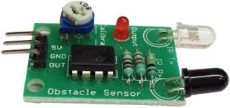
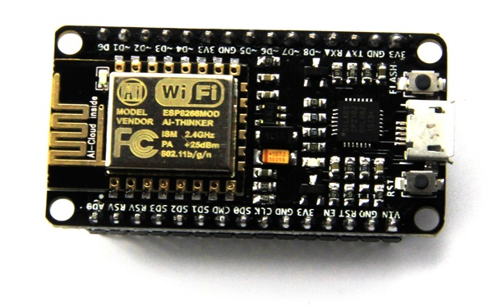
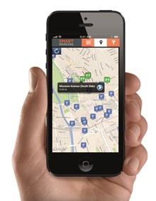
OVERVIEW
LAPTOP
PARKING SLOT
IR SENSOR MODULE
ESP8266 NODE MCU
MODULE
ANDROID APP

Slide 6

BLOCK DIAGRAM
PARKING SLOT
IR SENSOR MODULE
ESP8266 NODE MCU
MODULE
LAPTOP/SERVER
“SMART-PARKO”
ANDROID APP

Slide 7
IR SENSOR MODULE
IR sensor basically consist an IR LED and a Photodiode, this pair is generally called IR pair or Photo coupler.
IR sensor work on the principal in which IR LED emits IR radiation and Photodiode sense that IR radiation.
Photodiode resistance changes according to the amount of IR radiation falling on it, hence the voltage drop across it also changes and by using the voltage comparator (like LM358) we can sense the voltage change and generate the output accordingly.

Slide 8
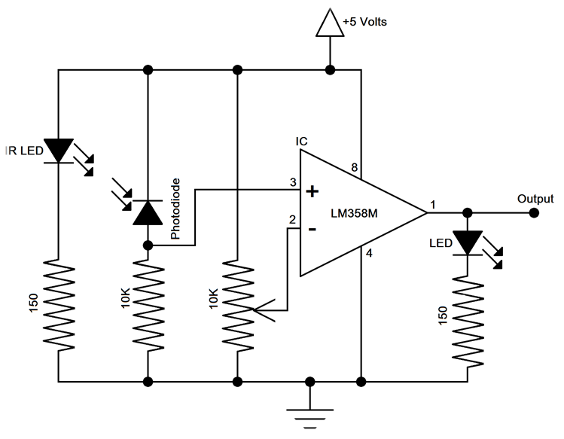
CIRCUIT DIAGRAM: IR SENSOR MODULE

Slide 9
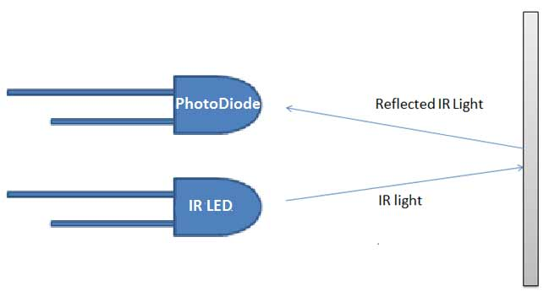
IR SENSOR MODULE
WORKING
Both the IR LED and Photo diode are placed in parallel (side by side), facing both in same direction.
when a object is kept in front of IR pair, the IR light gets reflected by the object and gets absorbed by photodiode..
To build an IR module, we mainly need IR pair (IR LED and Photodiode) and LM358 with some resistors and a LED.

Slide 10
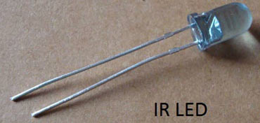
IR SENSOR MODULE
IR LED
IR LED emits light, in the range of Infrared frequency. IR light is invisible to us as its wavelength (700nm – 1mm) is much higher than the visible light range.
IR LED looks like a normal LED and also operates like a normal LED.

Slide 11
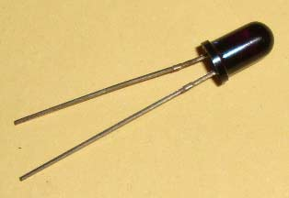
IR SENSOR MODULE
PhotoDiode
PHOTO DIODE
Photodiode is considered as Light dependent Resistor (LDR).
Photodiode operated in Reverse Bias.
It start conducting the current in reverse direction when Light falls on it.

Slide 12
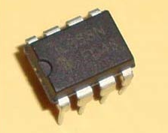
LM358
IR SENSOR MODULE
LM358
LM358 is an operational amplifier (Op-Amp)
In this circuit we are using it as a voltage comparator.
We have inputs at PIN 2 & 3 and output at PIN 1. Voltage comparator has two inputs, one is inverting input and second is non-inverting input (PIN 2 and 3 in LM358).
When voltage at non-inverting input (+) is higher than the voltage at inverting input (-), then the output of comparator (PIN 1) is High.

Slide 13
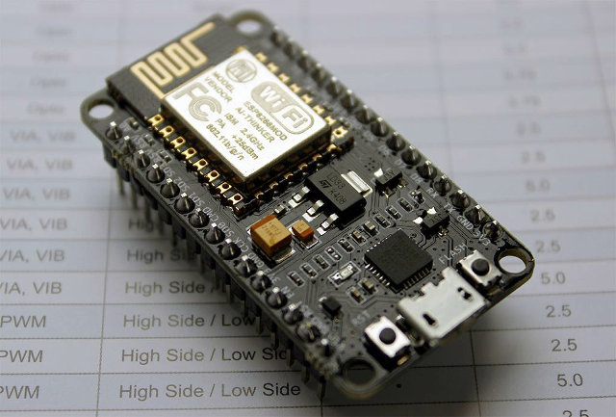
ESP8266 NODE MCU MODULE
ESP8266 (presently ESP8266EX) is a chip with which manufacturers are making.
Development / Prototyping board [Arduino like fully programmable]
Programmed using Arduino IDE.
Wirelessly networkable micro-controller modules.

Slide 14
ESP8266 NODE MCU MODULE
ESP8266 is a system-on-a-chip (SoC) with capabilities for 2.4 GHz Wi-Fi (802.11 b/g/n, supporting WPA/WPA2).
General-purpose input/output (16 GPIO).
Analog-to-digital conversion (10-bit ADC).
Serial Peripheral Interface (SPI).
UART (on dedicated pins, plus a transmit-only UART can be enabled on GPIO2).
Pulse-width modulation (PWM).

Slide 15
ESP8266 NODE MCU MODULE
ESP8266 chip needs 3.3V power for working or it contains an microUSB port, so that it can be powered through usb cable.
ESP8266 can be used as an access point or it can be connected to another network.
When it is connected to a network, module can be controlled from other device remotely.
Using an app we can control the devices which are connected with the esp8266 module.
Low cost.

Slide 16
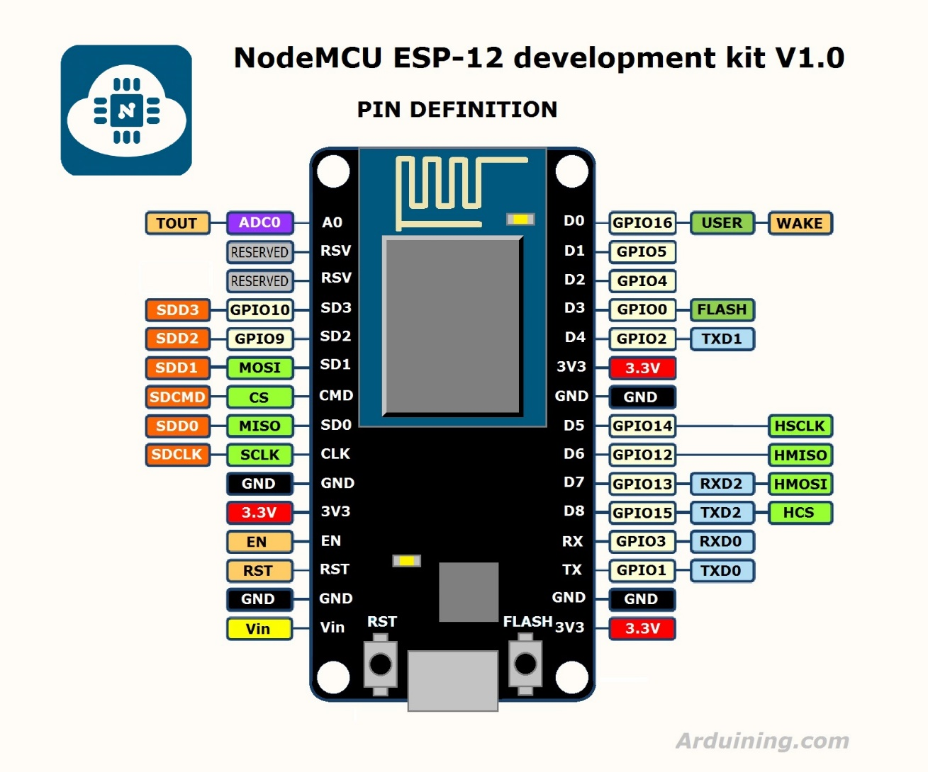
ESP8266 module pinout

Slide 17
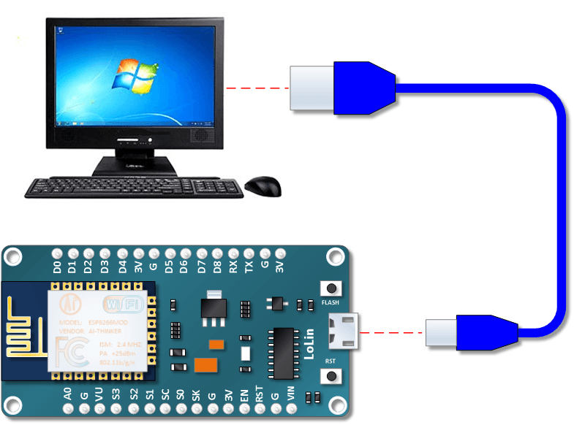
Power the Node MCU ESP8266 via the USB Port

Slide 18
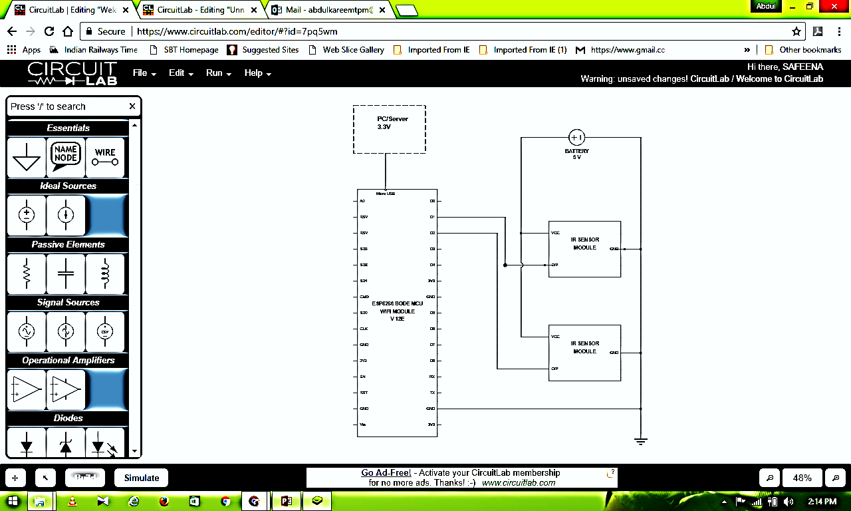
OVERALL CIRCUIT DIAGRAM

Slide 19
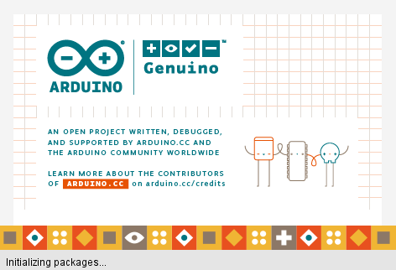
Programming using Arduino IDE
Programmed Using Arduino IDE.
Using ESP8266 Node MCU Board Manager.

Slide 20
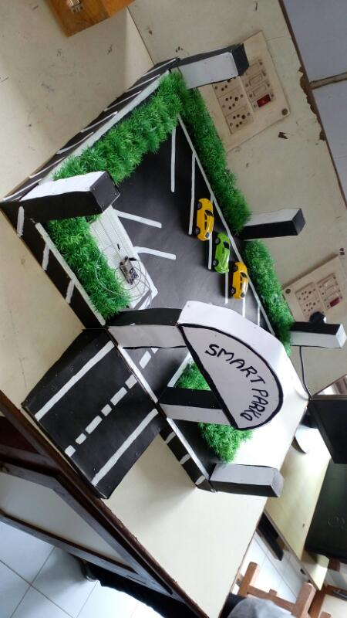
PARKING SLOT PROTOTYPE MODEL

Slide 21
ANDROID APPLICATION
“SMART-PARKO” is the android program of apk format.
Developed Using MIT App inventor and Android Studio.
When user opens this app, Users phone GPS system will detect the position an sync with google map.
Through this user can spot parking available parking station.
Proceeding next screen user will get the Available number of slots for parking car.
Its makes much easier to park cars.

Slide 22

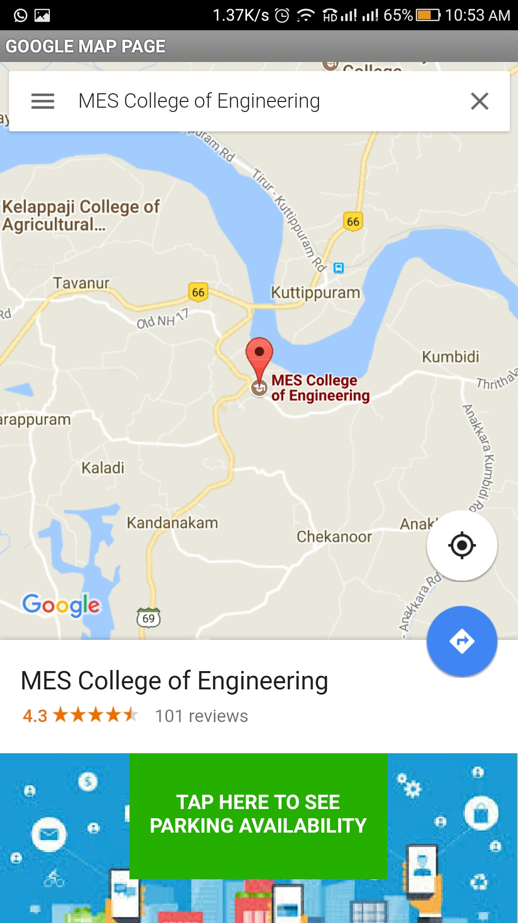
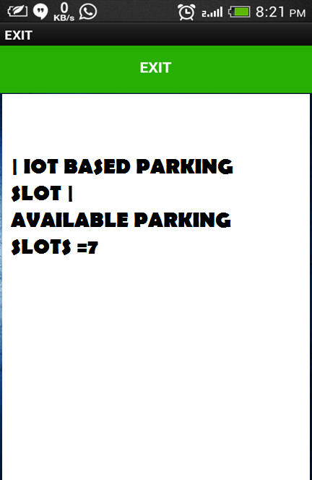
SCREENSHOTS OF ANDROID APP “SMART-PARKO”

Slide 23
CONCLUSION
By this project we introduce a innovative solution for car parking difficulties.
By using a simple android app “Smart-Parko”, driver can navigate to nearby car parking slots and number of slots availability.
By this it:
saves fuel
Time
Optimized parking
Reduced traffic
Reduced pollution.

